Slide 1
Office 365 Development Overview
July 2014

Slide 2

Agenda slide
Intro
Office 365 App Model
Office 365 APIs
Tools
Resources
Notes:
What new APIs are available, in preview, in the Office 365 Platform
How to use these API’s in your platform of choice
Some sample business scenarios for leveraging these API’s
Level: Intermediate
Audience: Developer Essentials

Slide 3
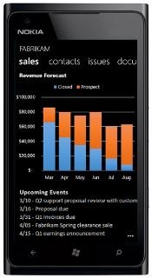
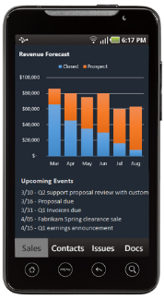
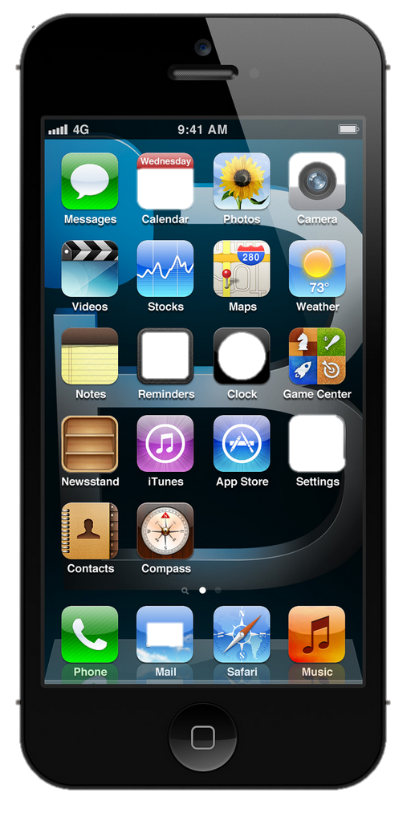




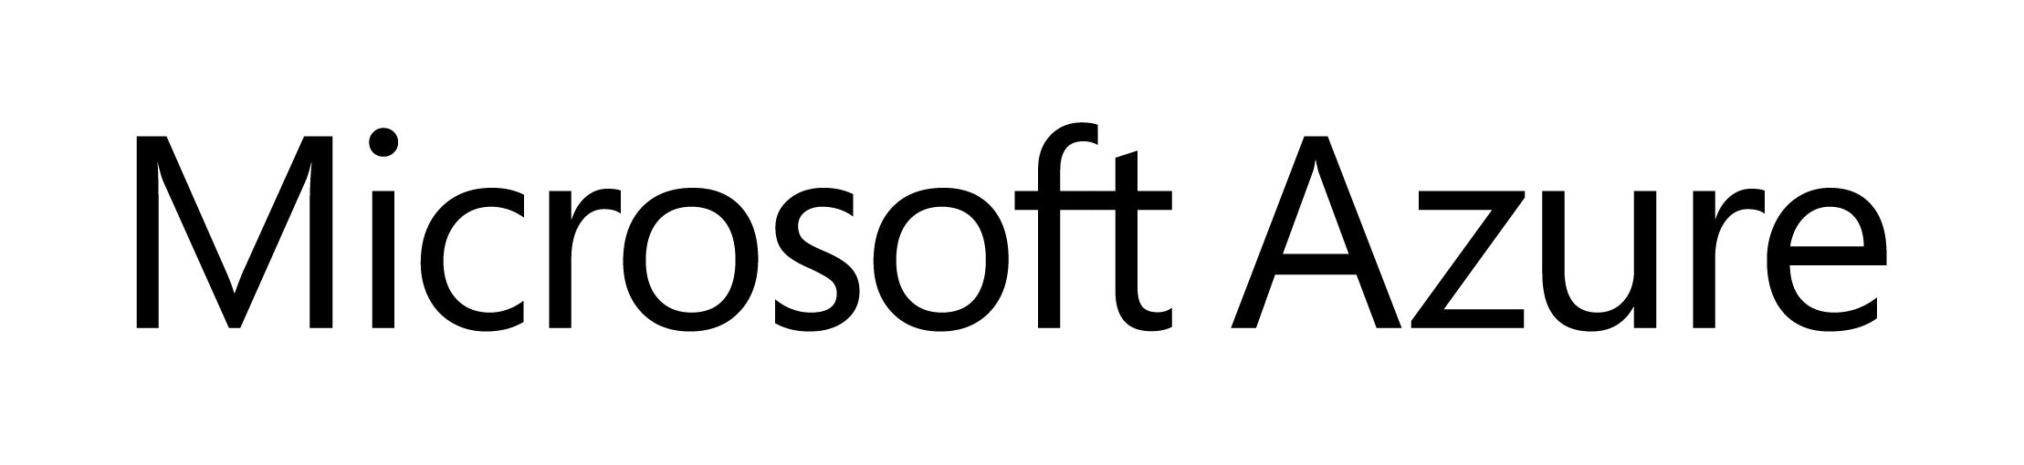


The Office development platform
Everywhere
HTML
Modern
Language agnostic
Web Application Host
Services
Azure AD applications
Office Graph
Files
Mail
Calendar
Contacts
Lync
Social

Slide 4
Office 365 App Model

Slide 5


Contextual Apps
Your Apps, our UI
Surface your apps in the Office 365 platform
In Context
In context of your business users productivity activities
Reach
In Office Client, Office Online and Modern Apps
Notes:
The Cloud App Model provides a loosely coupled architecture for building apps in SharePoint 2013. This loosely coupled architecture gives the freedom of choice for developers in the technologies they use to not only host their applications but also the tools they use to write them. These apps leverage industry web standards such as HTML, JavaScript, jQuery, JSON, REST, OData and OAuth to provide apps an integrated user experience, yet architecturally provides for loose coupling with SharePoint 2013.
Apps for SharePoint execute “off-server” which allows for the app to scale independently of SharePoint and provides for a more secure SharePoint environment. You have complete control how apps interact with SharePoint. IT has complete control on how users discover, acquire and license apps. IT can specify which apps are white listed for install, or provide a mechanism where users can request an app that requires IT approval to install.
Apps can be accessible from any device with a web browser whether it be a PC, Tablet or smart phone. If it has a web browser that supports the latest web standards then it can be used.
Supporting Technologies
Client Side Rendering
Cloud App Model
REST End-Points
Client Object Model
OAuth 2.0
Visual Studio
NAPA

Slide 6

Build apps
Web Standards
Apps are built using industry proven web standards such as HTML, JavaScript and REST
Scalable and Safe
Apps are independently scalable which reduces total cost of ownership. Apps are secured and isolated from SharePoint
Accessible
Apps can be accessed from any device with a web browser.
Notes:
The Cloud App Model provides a loosely coupled architecture for building apps in SharePoint 2013. This loosely coupled architecture gives the freedom of choice for developers in the technologies they use to not only host their applications but also the tools they use to write them. These apps leverage industry web standards such as HTML, JavaScript, jQuery, JSON, REST, OData and OAuth to provide apps an integrated user experience, yet architecturally provides for loose coupling with SharePoint 2013.
Apps for SharePoint execute “off-server” which allows for the app to scale independently of SharePoint and provides for a more secure SharePoint environment. You have complete control how apps interact with SharePoint. IT has complete control on how users discover, acquire and license apps. IT can specify which apps are white listed for install, or provide a mechanism where users can request an app that requires IT approval to install.
Apps can be accessible from any device with a web browser whether it be a PC, Tablet or smart phone. If it has a web browser that supports the latest web standards then it can be used.
Supporting Technologies
Client Side Rendering
Cloud App Model
REST End-Points
Client Object Model
OAuth 2.0
Visual Studio
NAPA

Slide 7

Build sites
Accelerate Site Creation
Sites can be customized and themed with apps or a few clicks in the browser.
Simple Site Customization
SharePoint sites are built using web standards making it easy to customize with industry standard web design tools
Adaptive Experiences
Sites can adapt their experiences based on the user.
Notes:
SharePoint has always strived to make site design customizations easy and that continues with SharePoint 2013. Now you can apply theming to a site with a few simple clicks of the mouse or touches of the screen. The new theming features include choosing a color palette and selecting a background image for your site.
With SharePoint’s extensive use of web standards, it now also embraces client side rendering. Client side rendering allows a web designer to understand the context of a site while customizing it with industry standard web design tools they are most familiar with. No longer does a designer have to understand the architecture of SharePoint in order to customize a site. Now sites can be designed with little or no tweaking after the hand off.
SharePoint 2013 offers new adaptive experiences for users of your sites. These experiences can be customized to provide contextual and relevant information for the user.
Supporting Technologies
Built In site theming
Client Side Rendering
SharePoint Design Manager
Search By Content WebPart

Slide 8

Build for the cloud
Write once, run anywhere
An app can run outside the firewall in the cloud and from inside the firewall in a data center.
Hosting freedom
Apps can be hosted on any platform giving you complete freedom.
Re-use logic and assets
Build apps that can share logic and code with other web hosted solutions. Re-use existing services and assets within you app.
Notes:
By nature the Cloud App Model allows for the implementation of the app to be independent of the SharePoint platform. This gives you freedom of choose in how you develop and host your apps. This means you could develop them using Microsoft tools or non-Microsoft tools such as Eclipse. You can host the on Windows Azure or host them in Linux, Amazon Web Services, etc… The choices are endless and completely up to you.
The apps you right can re-use logic and code you already have for other web based apps or services. Or you can use logic and code for an app in other web apps or services. That’s the power and freedom of the cloud.
Supporting Technologies
Cloud App Model
Platform Agnostic

Slide 9









Modern app development
Apps
Products and platforms
Services and data
Expense
calculator
Vacation
request
Event
planning
Help-desk
support
Learning management
Risk
management
App catalog and store
Notes:
It’s worth spending some time taking you through how we think about modern app development at Microsoft. We have a series of products and platforms like SharePoint and Office that provide a lot of great out-of-the box functionality to help us be productive. To get even more from these products we want to be able to bring information in from other places. Services and data sources like Dynamics, Bing or something that lives out on the web or in the cloud.
With the latest version of SharePoint we’re making it easier to bring together rich web services and data to create powerful new apps. Apps run outside of the SharePoint process, are hosted externally and can be exposed through REST API’s.
Today there are more than 700,000 SharePoint application developers and with this release we’re providing them with a place to surface their apps through an online marketplace of rich partner solutions and applications designed to work with SharePoint and Office.

Slide 10

What is in it for developers?
Same code works in cloud and in on-premises
Build market place apps and reach all Office 365 customers easily
More flexible model with additional possibilities
Standard .NET development tooling
Notes:
Is that Tobias?

Slide 11

App Model Development
If you know general web development, you also know Office 365 development…

Slide 12
Apps for SharePoint Samples
Notes:
CompleteMe
HelpDesk
Research Tracker
City Tour

Slide 13
Apps for Office Samples
Notes:
WikiPedia (Word) https://github.com/OfficeDev/Office-Apps/tree/master/Wikipedia
People Graph (Excel) https://github.com/OfficeDev/Office-Apps/tree/master/PeopleGraph
Modern Trend (Excel) https://github.com/OfficeDev/Office-Apps/tree/master/ModernTrend
Warranty Repair App (Outlook) https://github.com/OfficeDev/Warranty-Repair-Response-Outlook-Mail-App

Slide 14



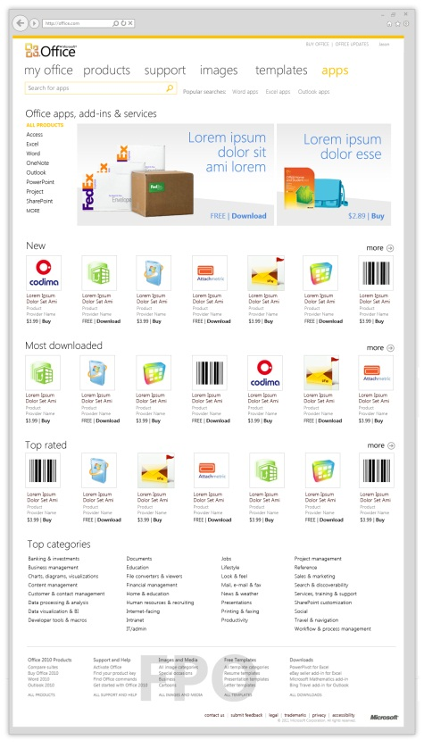


Apps and Market place license process
7
2
3
App Submission
Marketplace
SP Platform
APP
Storefront
APP
APP
Office AppHub
Office.com
4
6
1
5
Notes:
Develop App with license checks
Submit App to Marketplace via Seller Dashboard
App available for purchase in SharePoint Store
User/Manager purchases App from SharePoint Store
If ON-Prem License information is copied to local App Service Application
Apps can bypass the SP store for example for in-house development
User/Manager assigns users (required for user limited licenses) and uses the apps which can hosted in SP or be provider hosted
User runs App
App validates license using access points in App Service Application
App enforces license

Slide 15
Office 365 APIs

Slide 16
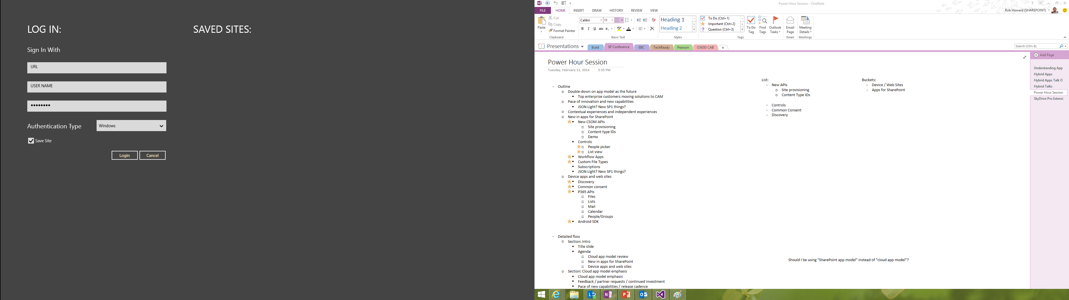
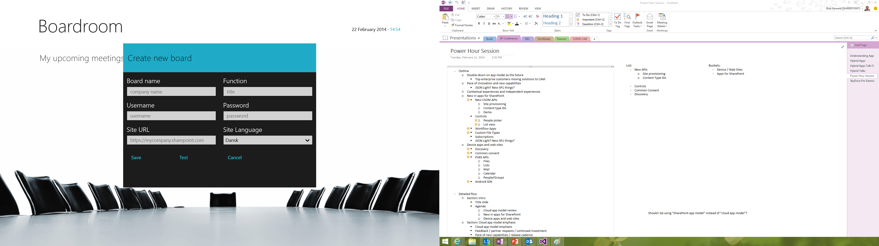
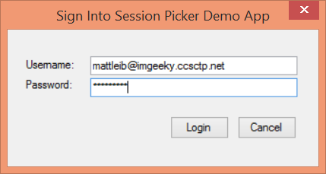
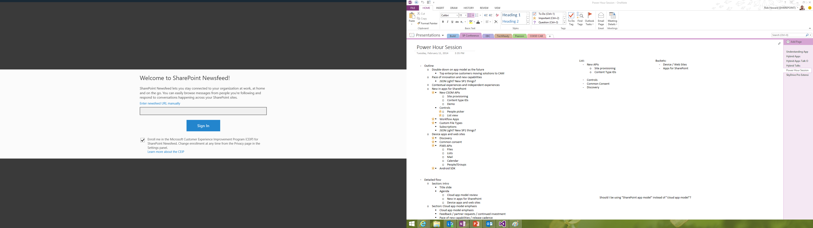
Office 365 device apps

Slide 17
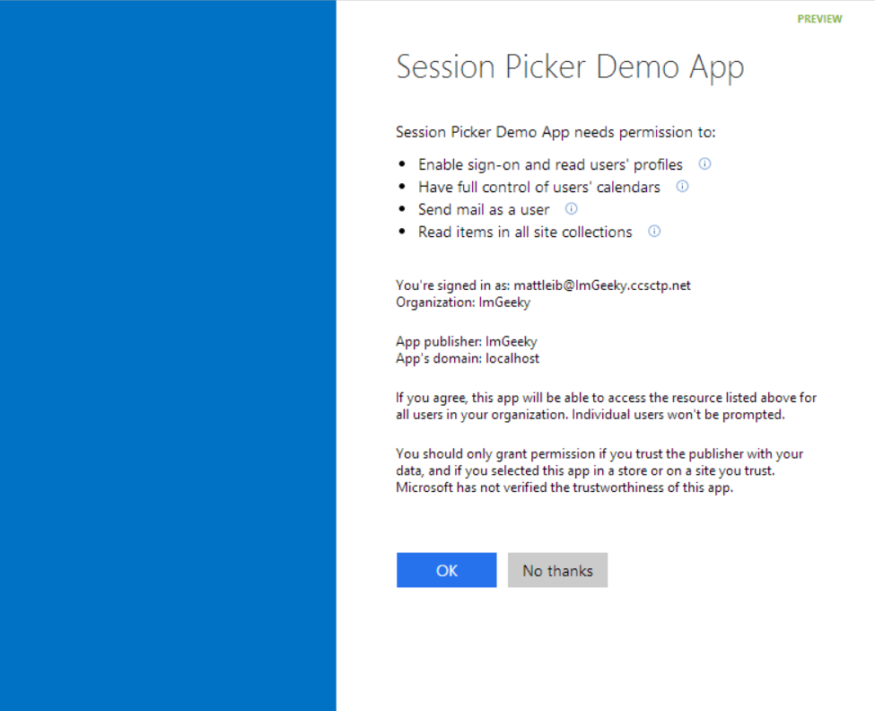
Common Consent

Slide 18
Office 365 APIs
SharePoint
Files
OneDrive
for Business
Active Directory
Exchange
Sites
Mail
Calendar
Contacts
Users
Groups

Slide 19
The SharePoint Client APIs will work
Lists and libraries
User profile
Search
Taxonomy
Feeds
…
_api
Execute query
REST/ OData
JavaScript library
Silverlight library
.Net CLR library
Custom client code

Slide 20
ASP.NET MVC project demo
Notes:
ASP.NET MVC Sampler https://github.com/OfficeDev/SharePoint-Power-Hour-Code-Samples/tree/master/O365ApiFullStack

Slide 21
Windows 8.1 project demo
Notes:
Meet and Greet App https://github.com/OfficeDev/SharePoint-Power-Hour-Code-Samples/tree/master/MeetAndGreet
Expense App (post receipts to OneDrive for Business and create Calendar entry in Exchange) – from Michael
Files (move files from OneDrive for Business to SharePoint site and vice versa) – from Chaks

Slide 22
Cordova Project demo
Notes:
WoodGrove App (not published yet – owned by DevDiv)

Slide 23
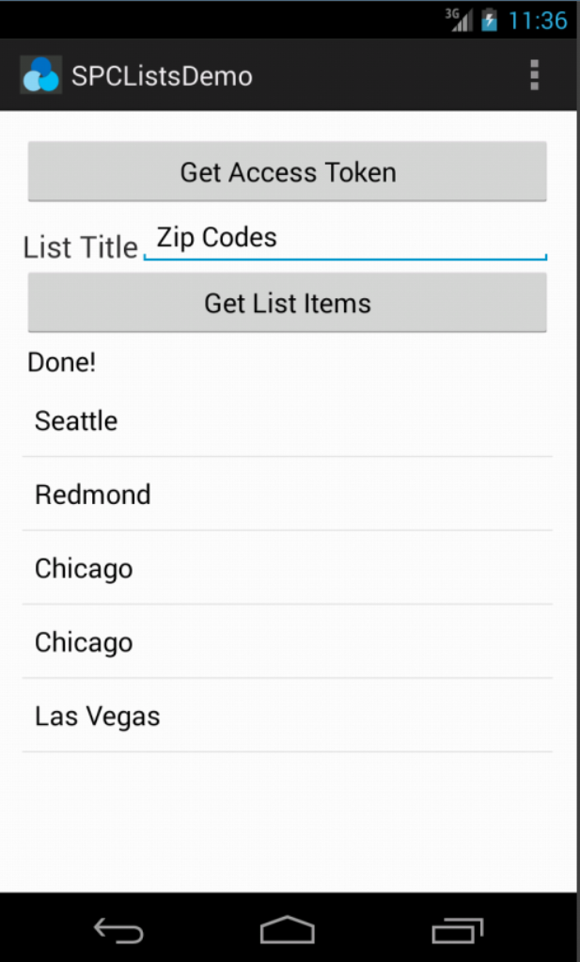
Office 365 SDK for Android
Available today on GitHub
SDK for native Android apps that use Office 365 APIs
Handles files, lists, mail, and calendar
Integrates with AD Auth library

Slide 24
Tools

Slide 25
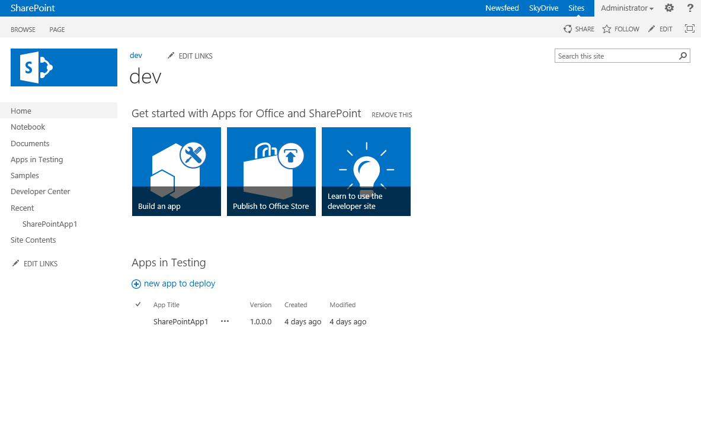
Developer template and usage
Enables remote development against the SharePoint farm
Also with on-premises deployments

Slide 26
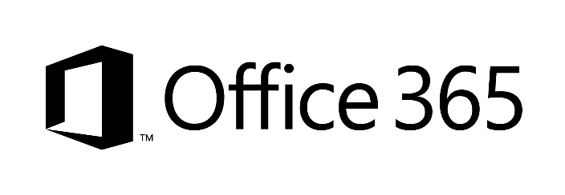

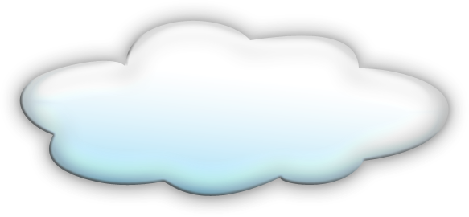


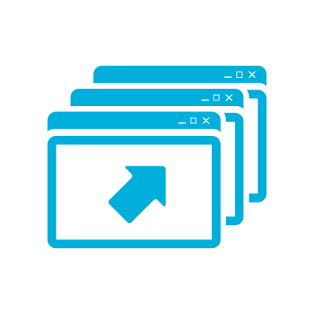



Developer sites and remote development
2
1
3
1
4
1
Notes:
Clients using remote development tools
Preferred option is to use Office365 – you can share even the same instance cross your App developers
You can also host your SharePoint Windows Azure IaaS server – so that development occures agains that instance
Just as for IaaS, you can do development againts shared on-premises instance – most likely you’d dedicate site collection per developer for testing usage
TFS – could be on-prem, hosted in IaaS platform or used as service from cloud

Slide 27
Resources

Slide 28
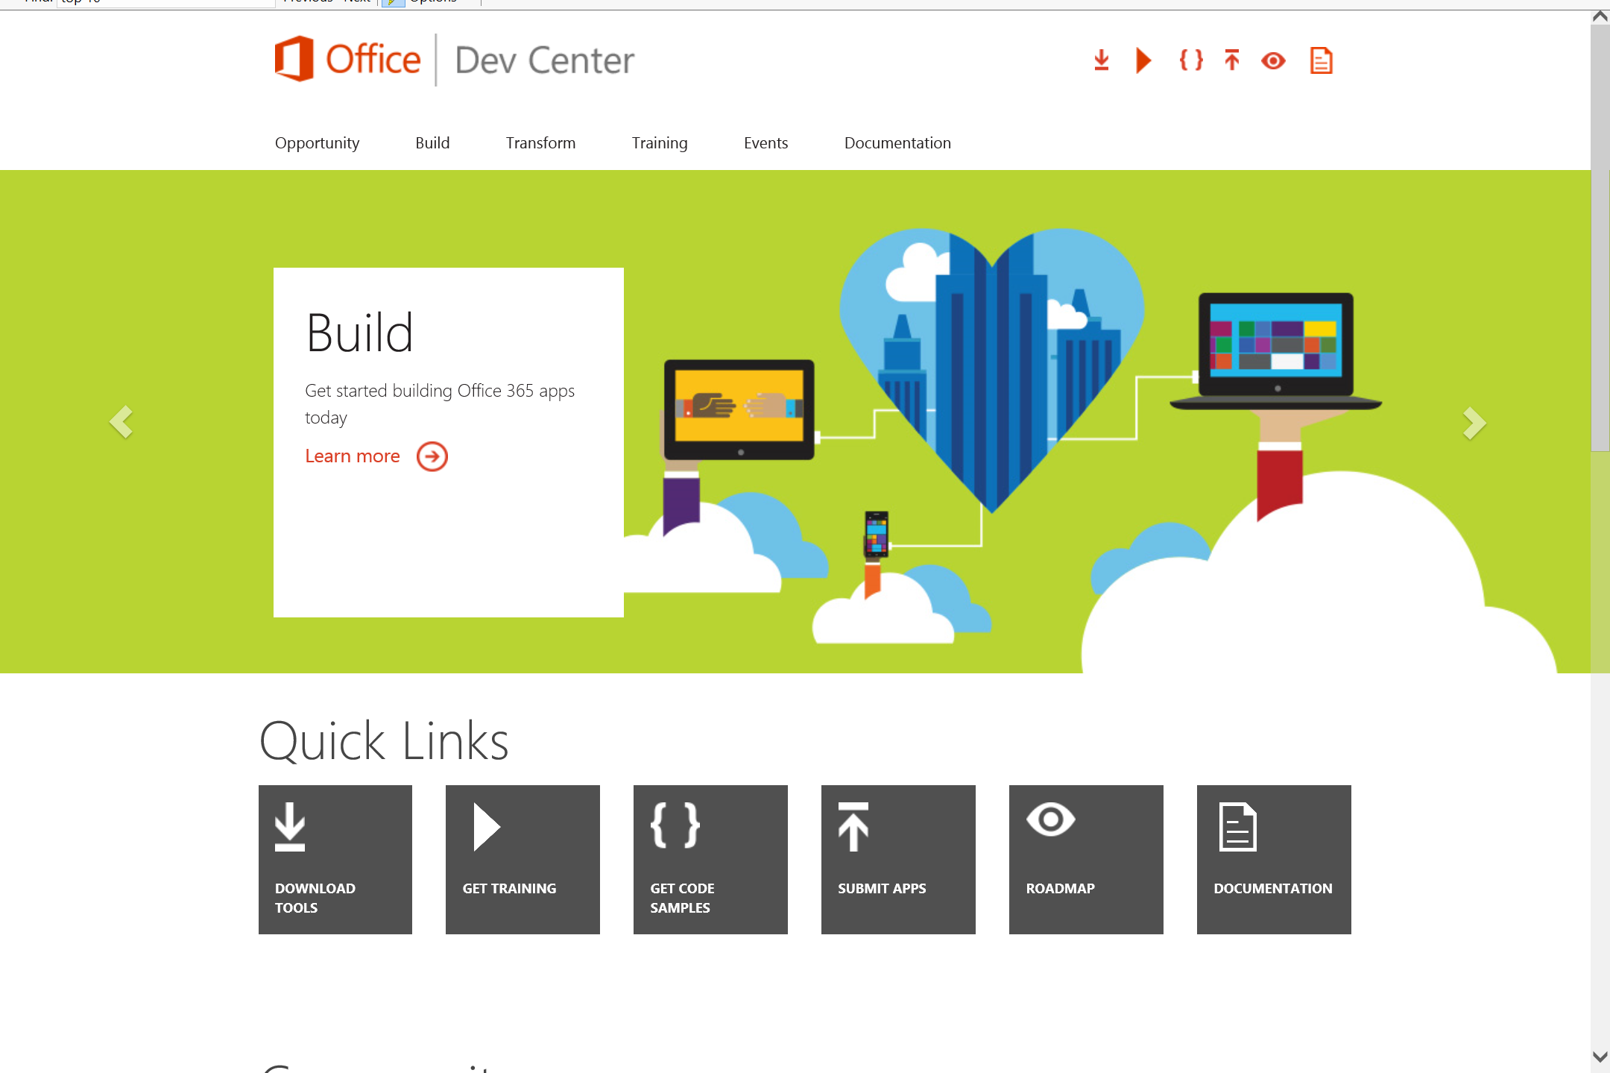
dev.Office.com
One stop shop for Office Developer Platform
Why
How
Migrate
Code Samples
Patterns & Practices
API Reference
Community

Slide 29
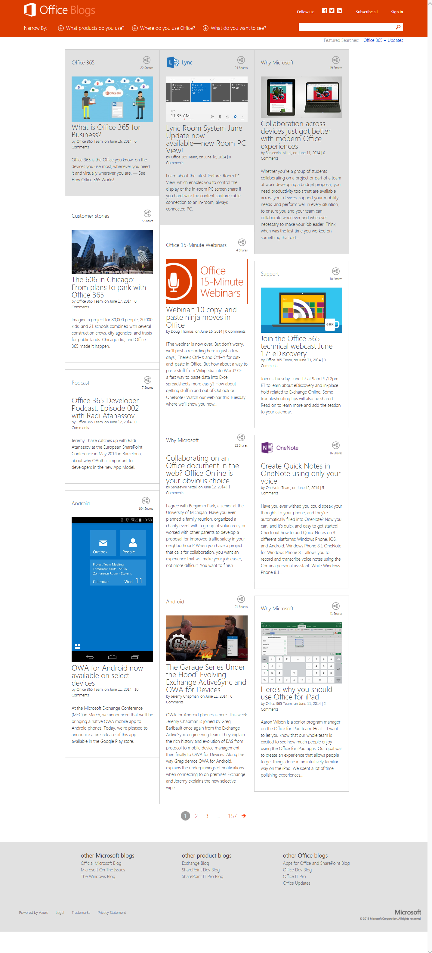
blogs.office.com/dev
Office 365 news
Dev announcements
Events
Garage Series videos
Weekly podcast

Slide 30
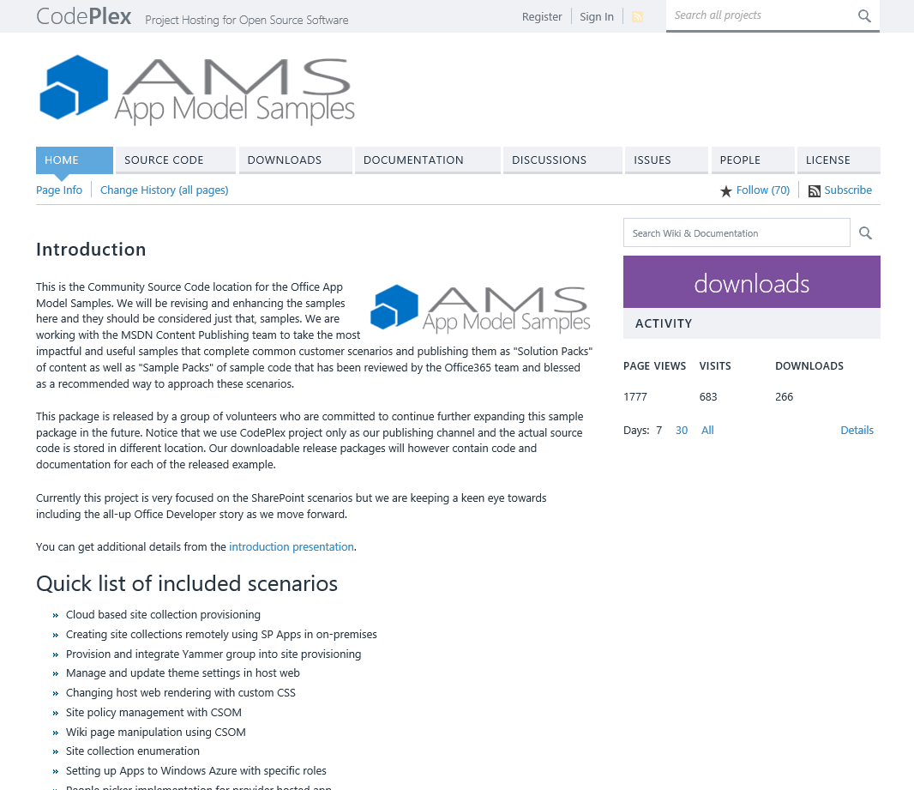
aka.ms/OfficeDevPnP
Patterns & Practices
Providing App Model Patterns for common Full Trust Code scenarios
30+ Visual Studio Projects
Common scenarios
Branding
Site Provisioning
Remote Event Receivers
Large file support
Taxonomy driven navigation
And much more…
Contribute
Open source coming soon!

Slide 31
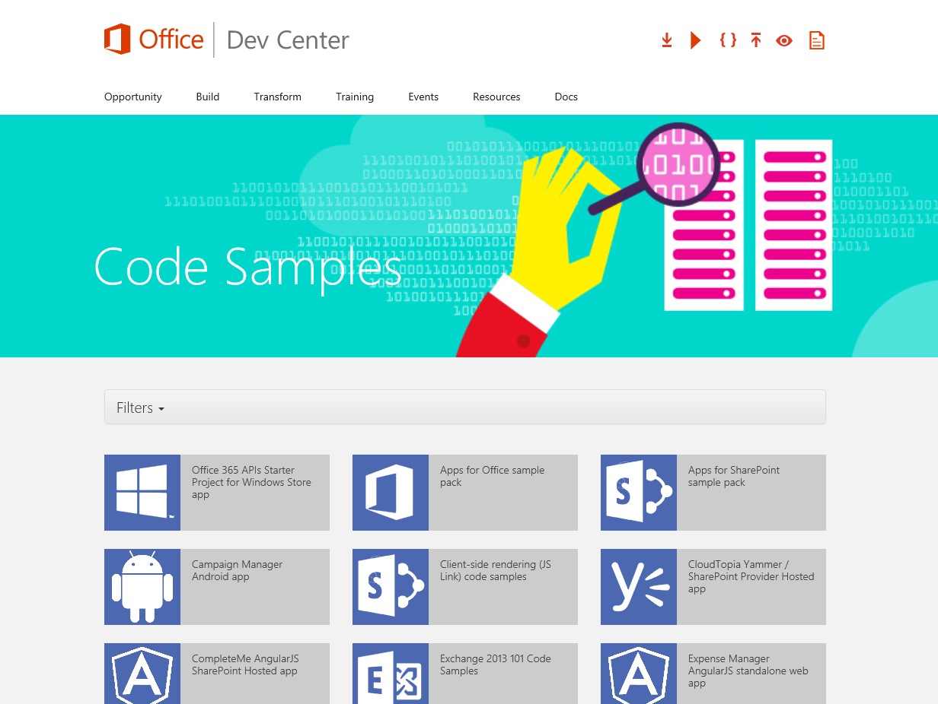
Code Samples
SDKs
Android SDK
Code Samples
WikiPedia App for Word
Coming soon…
Campaign Manager for Android
Expense Manager for Windows 8
Research Manager inc. AngularJS
Building Snippets for Word
Contribute
We want your enhancements and your samples!

Slide 32
Dev.
Office
.com
One stop shop for Office Developer Platform

Slide 33

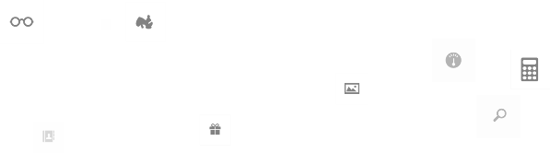
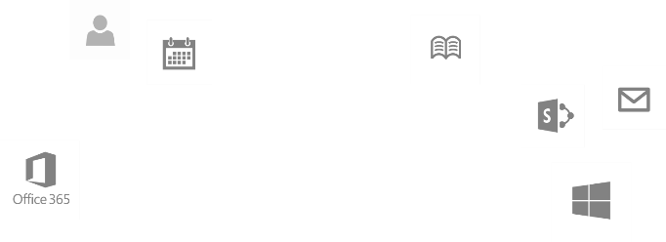
Calls to action
Explore our developer center
http://dev.office.com
Jumpstart into our training http://dev.office.com/training
Play with our code samples http://dev.office.com/code-samples
Get answers
http://aka.ms/AskSharePoint
http://aka.ms/AskOffice
Give feedback Drive our roadmap http://aka.ms/OfficeDevFeedback

Slide 34


Transform your code Providing App Model Patterns for common Full Trust Code scenarios
60+ Visual Studio projects Common scenarios
Branding
Site provisioning
Remote event receivers
Large file support
Taxonomy driven navigation
And much more…
Contribute
Open source coming soon!
Developer
Patterns & Practices
aka.ms/OfficeDevPnP

Slide 35
Microsoft Virtual Academy courses
2014
2015
Deep Dive into integrating Office 365 APIs with your mobile device development
Deep dive into the building blocks and services of the SharePoint platform
Deep Dive into integrating Office 365 APIs with your standalone web application development
Introduction to Office 365 Development
Deep Dive into the Office 365 App Model
Deep Dive into Office 365 Development on non-Microsoft Stack
Shipping your Office 365 App to the Office Store
Aug
Sept
Oct
Nov
Dec
Jan
Feb

Slide 36

© 2014 Microsoft Corporation. All rights reserved. Microsoft, Windows, and other product names are or may be registered trademarks and/or trademarks in the U.S. and/or other countries.
The information herein is for informational purposes only and represents the current view of Microsoft Corporation as of the date of this presentation. Because Microsoft must respond to changing market conditions, it should not be interpreted to be a commitment on the part of Microsoft, and Microsoft cannot guarantee the accuracy of any information provided after the date of this presentation. MICROSOFT MAKES NO WARRANTIES, EXPRESS, IMPLIED OR STATUTORY, AS TO THE INFORMATION IN THIS PRESENTATION.

